Slide 1
Today’s Lesson:
What:
transformations (dilations). . .
Why:
To perform dilations of figures on the coordinate plane.

Slide 2
What is it??
Remember, a dilation is any ____________________________.
The scale factor controls how large or ________________ the figure will become. We dilate according to the ______________________ .
More specifically, we ________________ EVERY coordinate by the scale factor.
re-sizing
small
scale factor
multiply

Slide 3
To be completed together in class:
Directions: Plot the original points as indicated. Connect the points to make a right triangle. Then, perform the given dilation.
Original Coordinates: | A (-2, 4) | B (2, 4) | C (2, 1)
Dilate by Scale Factor of 2 | A ( , ) | B ( , ) | C ( , )
-4 8
4 8
4 2

Slide 4
Directions: Plot the original points as indicated. Connect the points to make a right triangle. Then, perform the given dilation.
Original Coordinates: | A (-4, 6) | B (2, 6) | C (2, 3)
Dilate by Scale Factor of ½ | A ( , ) | B ( , ) | C ( , )
-2 3
1 3
1 1.5
Multiplying by ½ is the SAME as dividing by 2!!

Slide 5
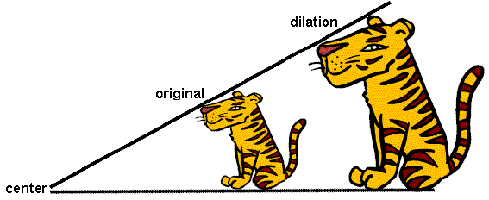
Soooo, when a figure is dilated by a scale factor GREATER than one, the image gets ________________________.
However, when a figure is dilated by a scale factor LESS than one (fraction), the image gets __________________________________ .
BIGGER
smaller

Slide 6
END OF LESSON
The next slides are student copies of the notes for this lesson. These notes were handed out in class and filled-in as the lesson progressed.
NOTE: The last slide(s) in any lesson slideshow (entitled “Practice Work”) represent the homework assigned for that day.

Slide 7
NAME:
Math-7 NOTES
DATE: ______/_______/_______
What: transformations (dilations). . .
Why: To perform dilations of figures on the coordinate plane.
Remember, a dilation is any ____________________________.
The scale factor controls how large or ________________ the figure will become. We dilate according to the ______________________ .
More specifically, we _____________________ EVERY coordinate by the scale factor.
To be completed together in class:
Directions: Plot the original points as indicated. Connect the points to make a right triangle. Then, perform the given dilation.
Original Coordinates: | A (-2, 4) | B (2, 4) | C (2, 1)
Dilate by Scale Factor of 2 | A ( , ) | B ( , ) | C ( , )

Slide 8
Directions: Plot the original points as indicated. Connect the points to make a right triangle. Then, perform the given dilation.
Original Coordinates: | A (-4, 6) | B (2, 6) | C (2, 3)
Dilate by Scale Factor of ½ | A ( , ) | B ( , ) | C ( , )
Multiplying by ½ is the SAME as dividing by 2!!
Soooo, when a figure is dilated by a scale factor GREATER than one, the image gets _________________________________.
However, when a figure is dilated by a scale factor LESS than one (fraction), the image gets __________________________________ .

Slide 9
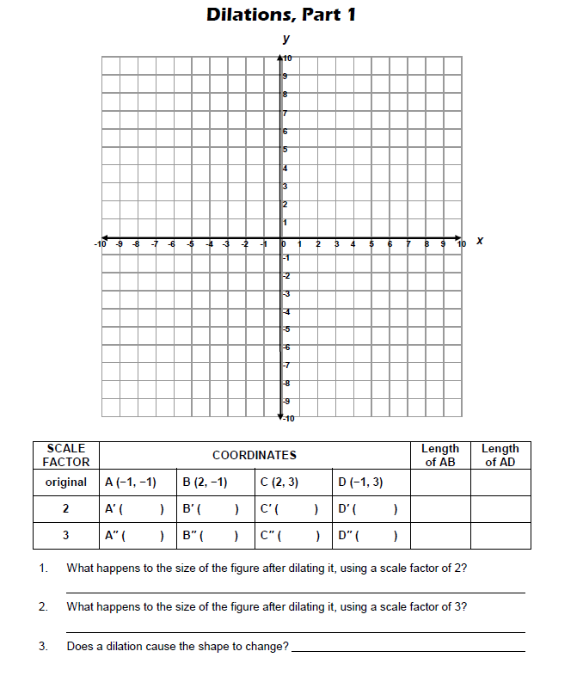
Dilations classwork
Date:_____/_____/__________
Name:___________________________________

Slide 10
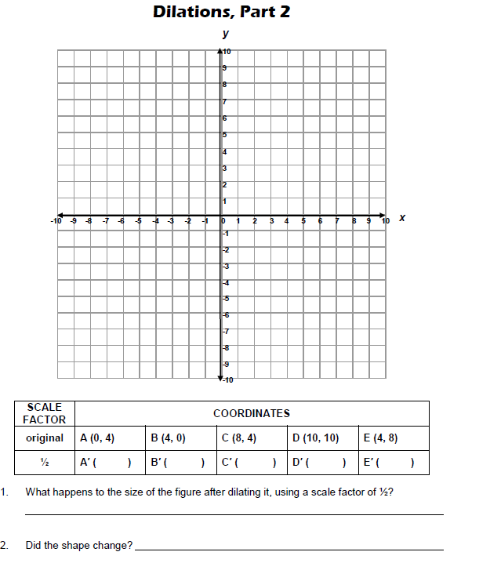

Slide 11
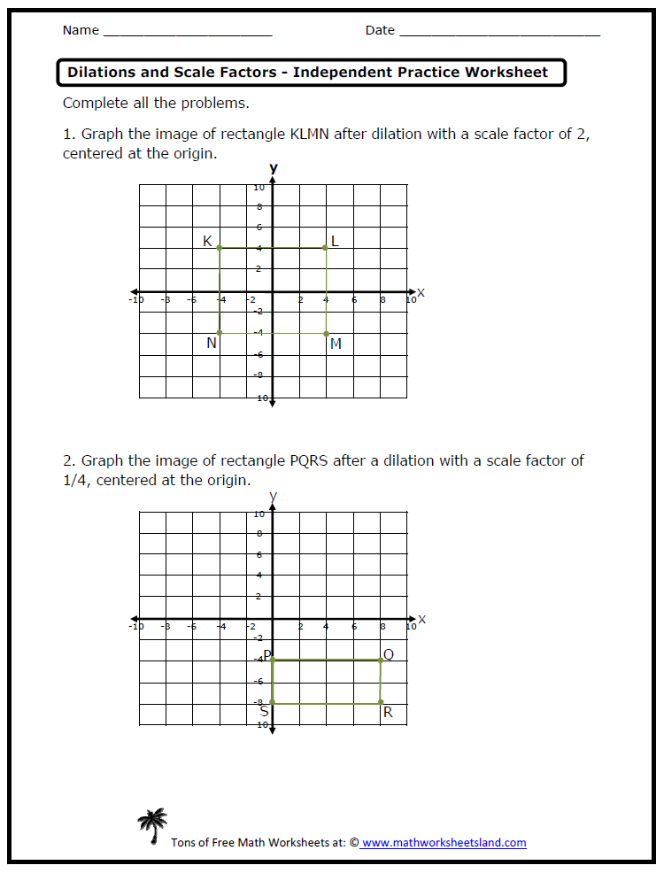
First, write down the ORIGINAL ordered pairs. Then, multiply.
Multiplying by ¼ is the same as dividing by 4!

Slide 13
Date:_____/_____/__________
Name:___________________________________
Math-7 “Dilations” Practice/ Homework
1. | 2. | 3.
4. | 5. | 6.

Slide 14
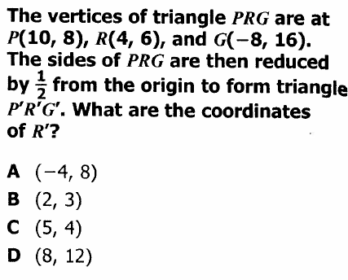
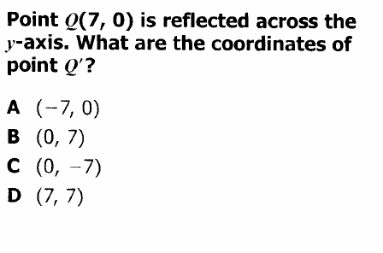
TRANSFORMATIONS QUIZ REVIEW
1. | 2.
Point A, located at (2, 5) is translated four units to the right and three units down. What is the location of A prime? A (6, 8) B (6, 2) C (-2, 8) D (-2, 2) | 4.
5. | 6.

Slide 15
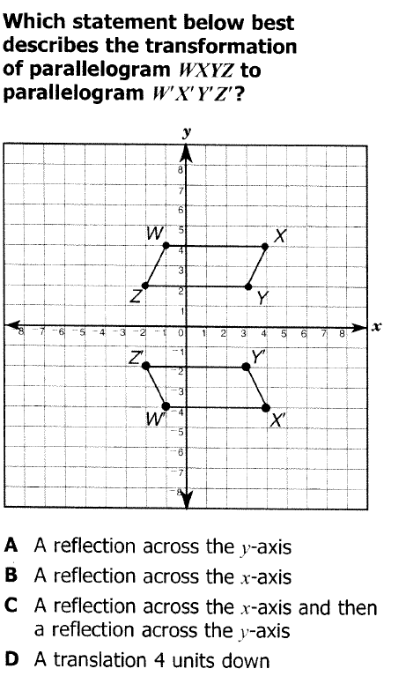
7. | 8. Point A, located at (-2, -4), is rotated 270 degrees counter-clockwise. Where is A prime? A (-2, 4) B (4, -2) C (2, 4) D (-4, 2)
9. Point A, located at (-1, -8), is rotated 90 degrees clockwise. Where is A prime? A (8, 1) B (-1, 8) C (-8, 1) D (8, -1) | 10. Point A, located at (-3, 5) is reflected over the x axis. Where is A prime? A (3, 5) B (-3, -5) C (3, -5) D (-3, 5)

